Slide 1

Rust Syntax and Data Types
Zachary Bennett
Lead Software Developer
@z_bennett_ | zachbennettcodes.com

Slide 2
Variables are immutable by default

Slide 3
// Variables
let my_number = 1;
let mut my_other_number = 2;
const IMPORTANT_NUMBER: i32 = 42;
let my_number = 2;
// “my_number” now points to the number ”2”
Defining an immutable variable
Defining a mutable variable
Defining a constant. A constant is always immutable and valid throughout the life of your program.
Shadowing a variable is possible. This is how to perform a transformation on a value where the variable remains immutable.

Slide 4
Comments
Simple
Documentation

Slide 5
// Comments
let my_number = 2; // Another comment
/// Subtracts “y” from “x”
pub fn subtract(x: i32, y: i32) -> i32 { x - y }
A simple comment looks like this
Comments can also be placed at the end of a line of code
Documentation comments are created with three forward slashes. These are used when creating external crates. Documentation is generated from comments like these.

Slide 6
Rust Syntax
Variables
Immutability and mutability
Comments
Demo

Slide 7
Primitive Data Types in Rust

Slide 8
Date Type Categories
Scalar
These are types that represent a single value
Compound
Types that represent multiple values

Slide 9

Scalar Types
Integer
Floating Point
Boolean
Character
Use dark text or icons instead of white on yellow or green shapes.

Slide 10
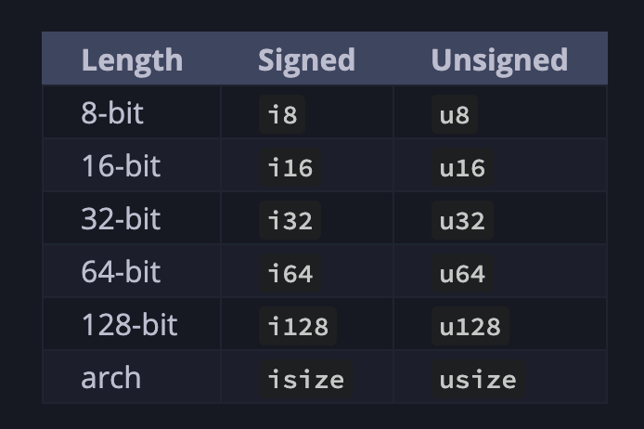
// The Integer Type
let my_number: i32 = 1;
let my_8_bit_int: i8 = -128;
let other_int: u8 = 128;
Defining integers

Slide 11
// More Primitive Scalar Types
let my_floating_point: f64 = 2.5;
let other_float: f32 = 2.0;
let this_is_true: bool = true;
let this_is_false = false;
let my_char: char = ‘A’;
Defining floating point values
Defining booleans
Defining a single character literal

Slide 12
Compound Types
Tuples
Arrays

Slide 13
// Primitive Compound Types
let my_tuple = (‘A’, 1, 1.2);
let my_arr = [1, 2, 3];
let my_arr_typed: [i32; 3] = [1, 2, 3];
Defining a tuple
Defining an array
Defining an explicitly typed array

Slide 14
Creating Custom Types

Slide 15
Custom Types
Structs
A combination of different data types which create a custom type
Enums
A way to define a custom type by explicitly defining its states

Slide 16
// Example struct
struct Coffee {
id: i64,
name: String
}
let coffee = Coffee {
id: 123456,
name: String::new(“Latte”)
}
Structs are defined by using the “struct” keyword alongside a name
Structs are your means of combining different data types together underneath the umbrella of a custom type
Instantiating a struct looks like this

Slide 17
// Example enum
enum CoffeeType {
HOT,
ICED
}
// Example usage
let my_coffee = Coffee {
id: 123456,
coffee_type: CoffeeType::HOT,
name: String::new(“Latte”) }
An enum is defined via the “enum” keyword
Using an enum looks like this

Slide 18
// Including data with enums
enum CoffeeType {
HOT(f32),
ICED(f32)
}
// Example usage
let my_coffee = Coffee {
id: 123456,
coffee_type: CoffeeType::HOT(102.5),
name: String::new(“Latte”) }
An enum can have data attached to it as well
Example of an enum with data attached. Here we have the temperature attached to it.

Slide 19
Primitive data types
Custom data types
Structs
Enums
Demo

